Slide 1
Rasterisation & Blinn-Phong Lighting
Dr. Hamish Carr & Dr. Rafael Kuffner dos Anjos

Slide 2

Agenda
Line Interpolation
Triangle Interpolation
Shading
COMP 5812M: Foundations of Modelling & Rendering

Slide 3
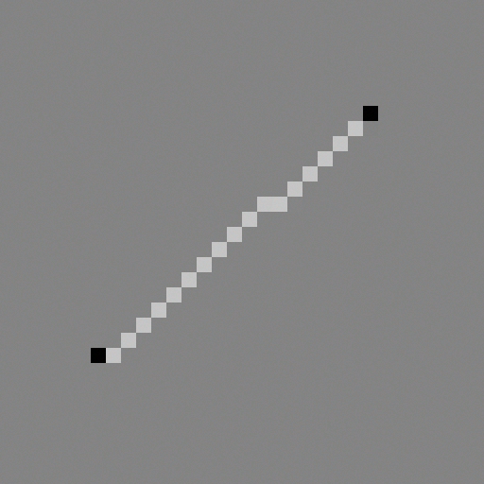
How to draw a line?
Bresenham’s Algorithm
Loop through explicit form with integer values:
Rarely used anymore
for (x = x0; x < x1; x++)
{ y = mx + c;
setPixel(x, y);
}

Slide 4
Interpolation
Let’s say we want a coloured gradient
At p, the line is 100% red, 0% blue
At q, the line is 0% red, 100% blue
In between, it varies smoothly
This process is called interpolation
p
q
COMP 5812M: Foundations of Modelling & Rendering

Slide 5
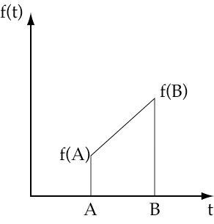
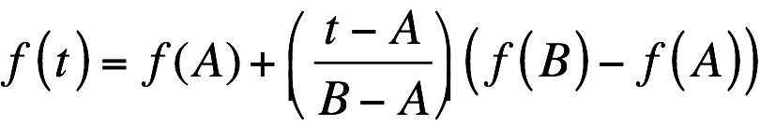
Linear Interpolation
Let f(x) be the colour
we use a straight line
f changes linearly:
So rasterise f at the same time as y

Slide 6
Implicit Form
We want to draw a line 1 pixel wide
all pixels within 0.5 pixels of line
we know how to measure distance
But this draws a line, not a segment
for (x = xMin; x < xMax; x++)
for (y = yMin; y < yMax; y++)
if (abs(distance((x, y), (x0, y0), (x1, y1))) < 0.5)
setPixel(x, y);

Slide 7
Parametric Interpolation
Much easier
Walk along the line one step at a time:
Choosing step size is important
for (t = 0.0; t <= 1.0; t += 0.001)
{
point_r = point_p + (point_q - point_p) * t;
colour = colour_p + (colour_q - colour_p) * t;
setColour(colour);
setPixel(round(r_x), round(r_y));
}

Slide 8


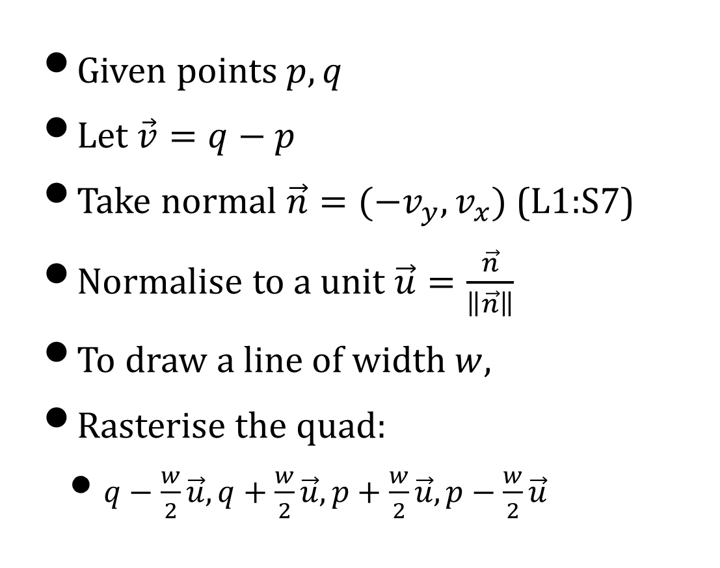



Line Quads
Given points $p,q$
Let $\vec{v}=q−p$
Take normal $\vec{n}=(−v_{y},v_{x})$ (L1:S7)
Normalise to a unit $\vec{u}=\frac{\vec{n}}{\left\|\vec{n}\right\|}$
To draw a line of width $w,$
Rasterise the quad:
$q−\frac{w}{2}\vec{u},q+\frac{w}{2}\vec{u},p+\frac{w}{2}\vec{u},p−\frac{w}{2}\vec{u}$
$$\vec{n}$$
$$q$$
$$\vec{u}$$
$$\vec{v}$$
$$p$$

Slide 9
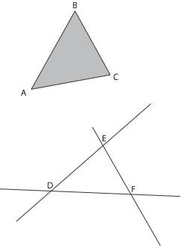
Triangles
Defined by 3 points:
Or by 3 lines
Drawing three lines is easy
But what about filled triangles?
Start with equations of triangles
COMP 5812M: Foundations of Modelling & Rendering

Slide 10
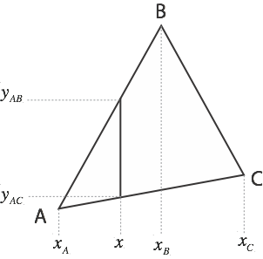
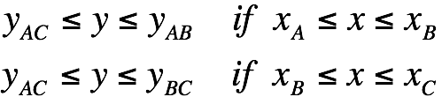
Explicit Form
For any x, specify valid y
Assumes B is above AC

Slide 11
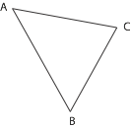
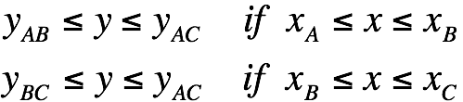
Explicit Form, II
If B is below AC:

Slide 12
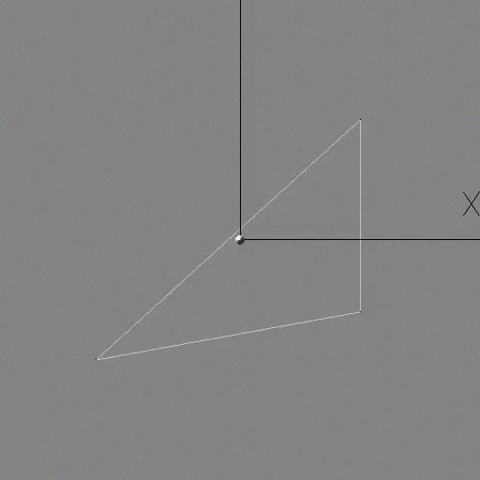
Raster Scan Algorithm
Algorithm scans one line at a time
raster scan (raster is Latin for a rake)
scan conversion of triangles to pixels

Slide 13
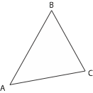
Explicit Algorithm
Also called linewise scan or raster scan
usually loops horizontally, not vertically
Sort A, B, C so Ax < Bx < Cx
Find slopes mAB, mAC, mBC,
Find y-intercepts cAB, cAC, cBC
for (x = Ax; x <= Bx; x++)
{ // for each column
yMin = mAC * x + cAC; yMax = mAB * x + cAB;
if (yMin < yMax)
swap(yMin, yMax);
for (y = yMin; y <= yMax; y++)
setPixel(x,y);
} // for each column

Slide 14
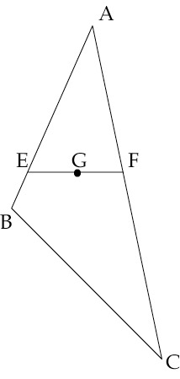
Linewise Interpolation
To compute f(G):
Interpolate f(E) from f(A), f(B)
Interpolate f(F) from f(A), f(C)
Interpolate f(G) from f(E), f(F)
Perform for each of R,G,B

Slide 15
Implicit / Normal Form
Based on normal form of lines:
Also known as the half-plane test
Look up L1:S10!

Slide 16
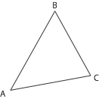
Winding Order
Inside depends on the winding order
which direction we wind
ABC is clockwise (CW)
inside on right
ACB is counterclockwise (CCW)
inside on left
COMP 5812M: Foundations of Modelling & Rendering

Slide 17
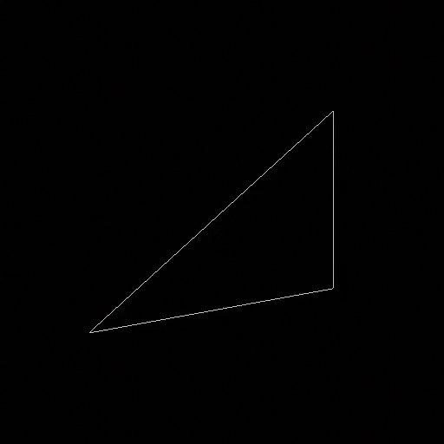
Half-Plane Test: What is inside the triangle?
Each test divides plane in half:
Red vs. Not-Red
Green vs. Not-Green
Blue vs. Not-Blue
Triangle is inside each

Slide 18
Implicit Algorithm
Assume CCW winding order (left is inside)
But what about colour interpolation?
As with lines, we need parametric form
for (x = xMin; x < xMax; x++)
for (y = yMin; y < yMax; y++)
if ( (x,y) leftOf (A,B) &&
(x,y) leftOf (B,C) &&
(x,y) leftOf (C,A))
setPixel(x,y);

Slide 19
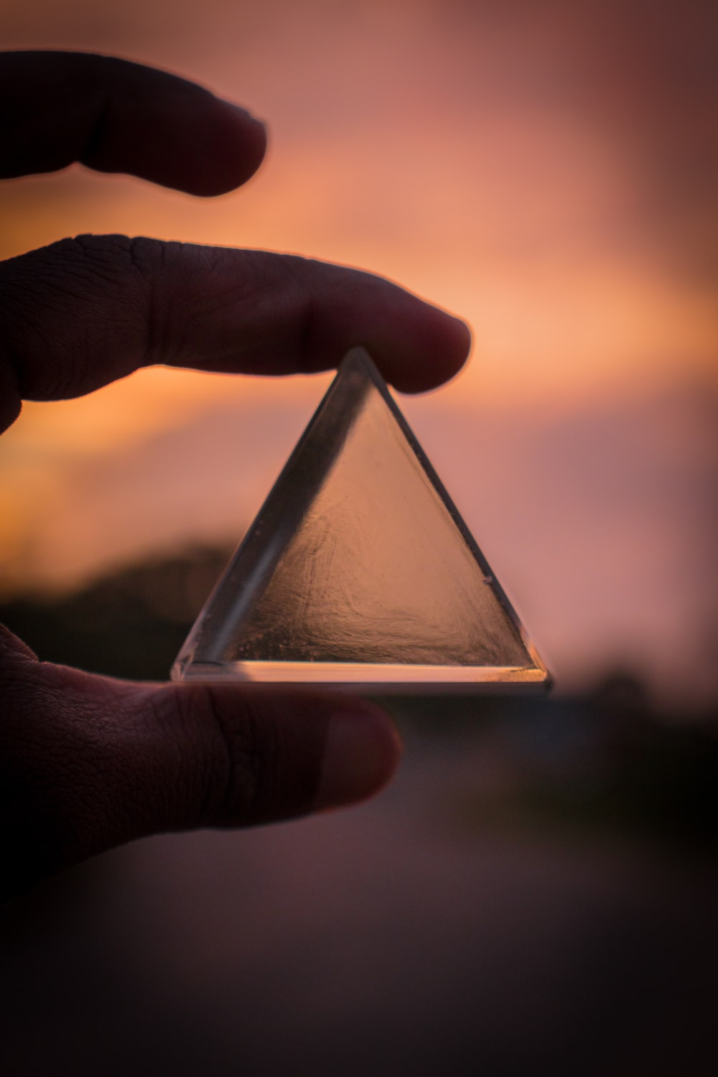
Parametric Form
For a line pq, t = 0.0 at p, t = 1.0 at q
How can we parameterize a triangle for interpolation?

Slide 20
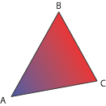
Triangle Interpolation
Pick a vertex A
Set 100% blue at A
Set 0% blue at CB
In between, varies linearly
perpendicular to CB
COMP 5812M: Foundations of Modelling & Rendering

Slide 21
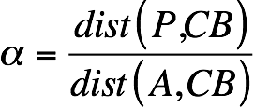
The Parameter α
Colour depends on distance from CB
Call this distance α
Parametrize so that:
α = 1.0 at A
α = 0.0 at BC
P
α

Slide 22
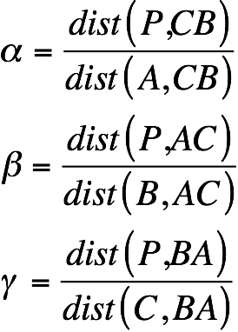
And, obviously...
For any point P

Slide 23
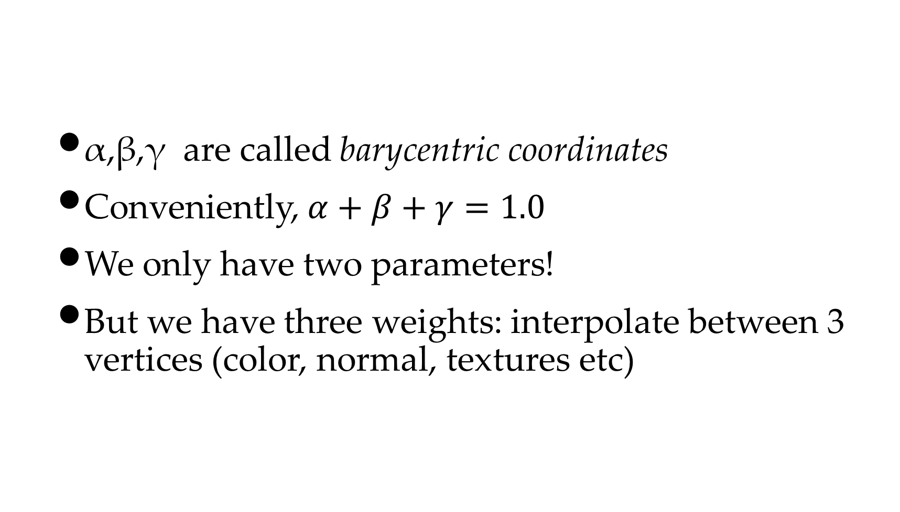
Barycentric Coordinates
α,β,γ are called barycentric coordinates
Conveniently, $α+β+γ=1.0$
We only have two parameters!
But we have three weights: interpolate between 3 vertices (color, normal, textures etc)

Slide 24
Parametric Algorithm
for (x = xMin; x < xMax; x++)
for (y = yMin; y < yMax; y++)
alpha = distance((x,y), BC) / distance(A, BC);
beta = distance((x,y), AC) / distance(B, AC);
gamma = distance((x,y), AB) / distance(C, AB);
if ((alpha < 0.0) || (beta < 0.0) || (gamma < 0.0))
continue;
colour = alpha * colour(A) + beta * colour(B)
+ gamma * colour(C);
setColour(colour);
setPixel(x,y);

Slide 25
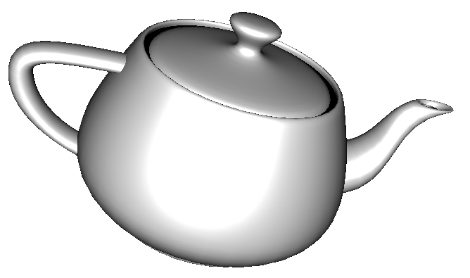
Shading

Slide 26
Perspective Interpolation
Assume ABCD is a square
E is not half-way between B & D visually
But it needs to be mathematically
So we have to correct it for the depth z
Depth z
Depth 0

Slide 27
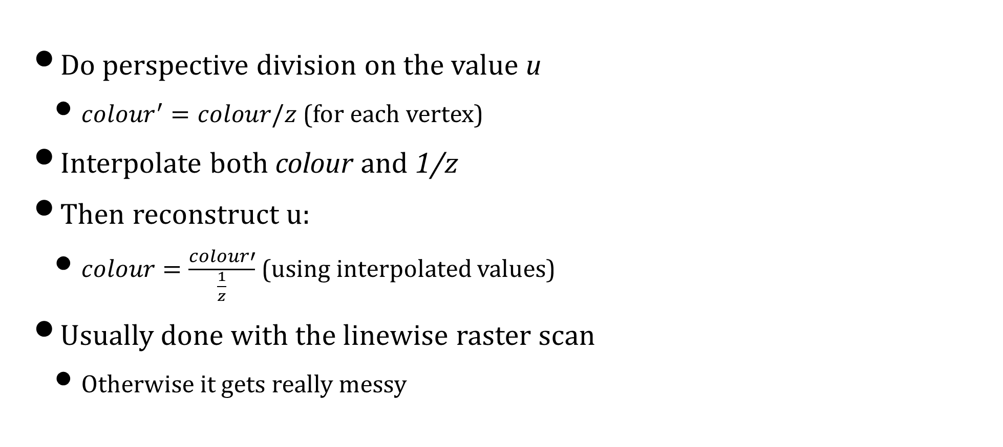
Hyperbolic Interpolation
Do perspective division on the value u
${colour}^{′}=colour/z$ (for each vertex)
Interpolate both colour and 1/z
Then reconstruct u:
$colour=\frac{colour′}{\frac{1}{z}}$ (using interpolated values)
Usually done with the linewise raster scan
Otherwise it gets really messy

Slide 28
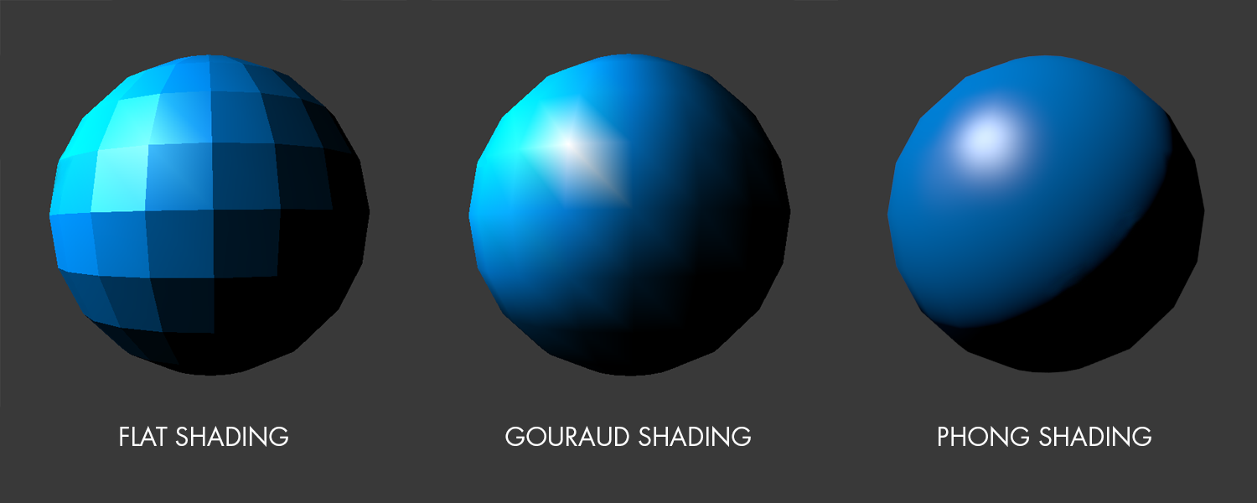
Gouraud vs. Phong Shading
Gouraud shading computes light per vertex
Then interpolates colour across triangle
Standard (old) OpenGL solution
Phong shading computes light per point
Interpolates normal across triangle
And is more expensive computationally

Slide 29
Local & Global Illumination
Global illumination simplifies lighting
All surfaces get the same lighting
I.e. the light interacts with every surface
Other objects don’t block the light source
And indirect lighting is ignored
Local illumination is better, but more costly
So we will use global illumination

Slide 30



Origin of Photons
Imperfect
Reflection
Angle
Stray
Photons
Surface
Normal
Eye
Perfect
Reflection
Angle
For any point, light comes from all over

Slide 31
Blinn-Phong Lighting Model
Total lighting at a point is:
specular (shiny) reflection, plus
diffuse (matt) reflection, plus
ambient (background) reflection, plus
emitted light

Slide 32
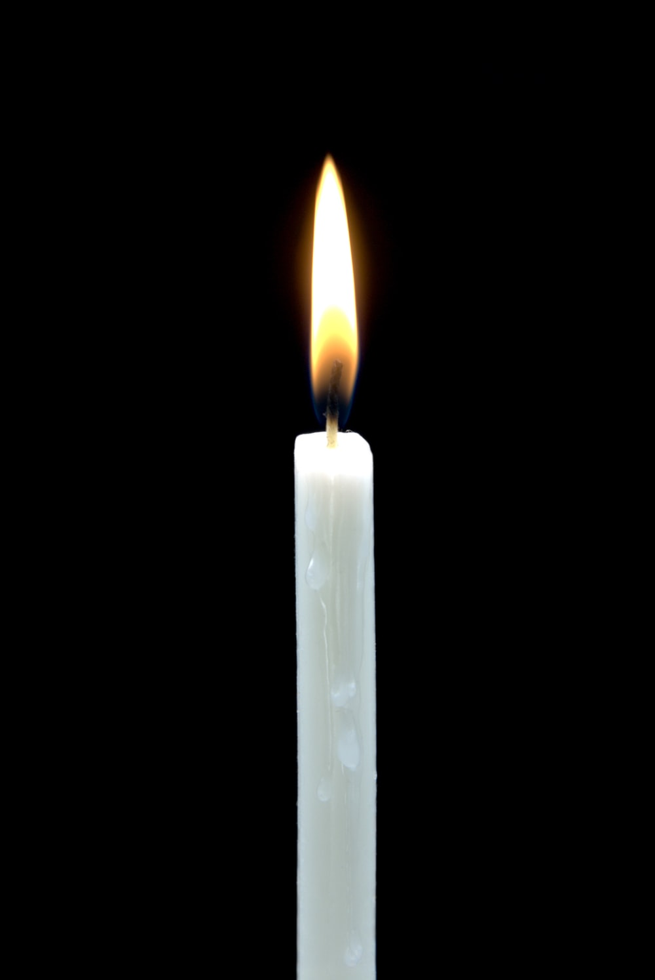

Emitted Light
Light from a glowing object
For simplicity, uniform in all directions
Not affected by incoming light
COMP 5812M: Foundations of Modelling & Rendering

Slide 33

Ambient Lighting
Some photons have bounced around
Hard to identify their source
Roughly same number everywhere
Stray
Photons
Surface
Normal
Eye
COMP 5812M: Foundations of Modelling & Rendering

Slide 34
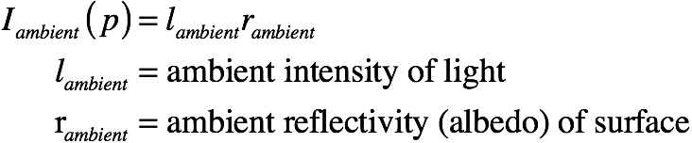
Ambient Light: Uniform on all surfaces, but some reflect more

Slide 35
Perfect Reflection
Angle of incidence = angle of reflection
Normal vector is bisector
Eye
q
q

Slide 36
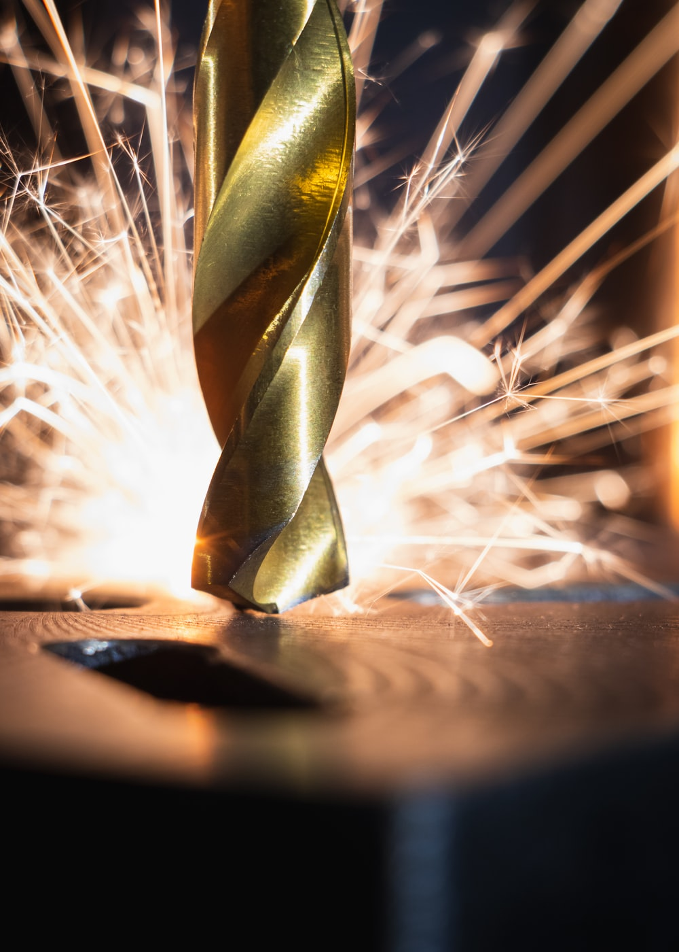
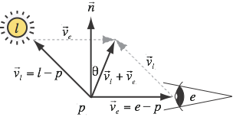
Specular Reflection
Specular light spreads out a little bit
Reflects strongly for angles close to perfect
i.e. if the bisector is close to n
COMP 5812M: Foundations of Modelling & Rendering

Slide 37
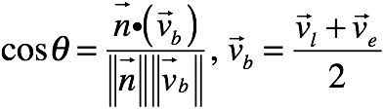
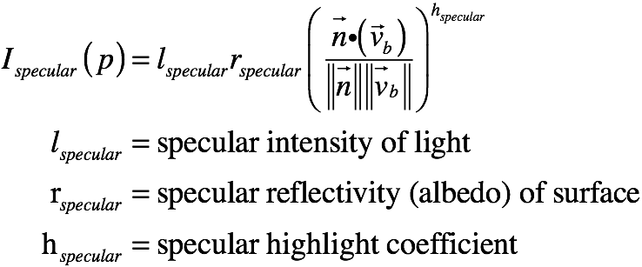
Specular Reflection
Based on angle between normal and bisector
Use an exponent to adjust size of highlight

Slide 38
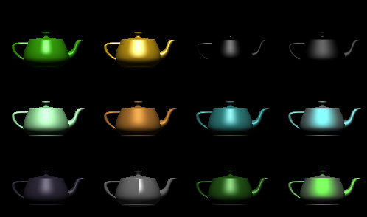
Specular Highlights

Slide 39

Diffuse Light
Diffuse light is from rough surfaces
rough at the microscopic scale
normal is essentially random
although surface is oriented
Diffuse light still uses normal vector
COMP 5812M: Foundations of Modelling & Rendering

Slide 40
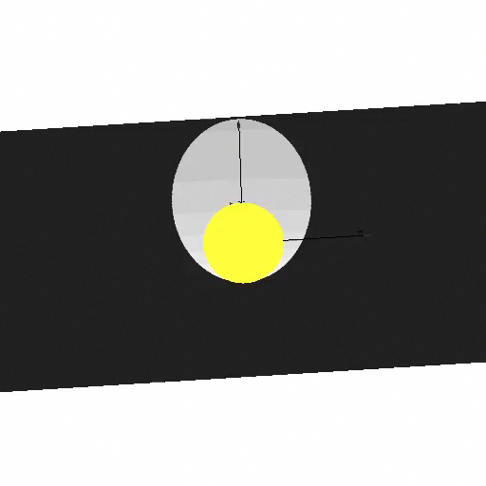
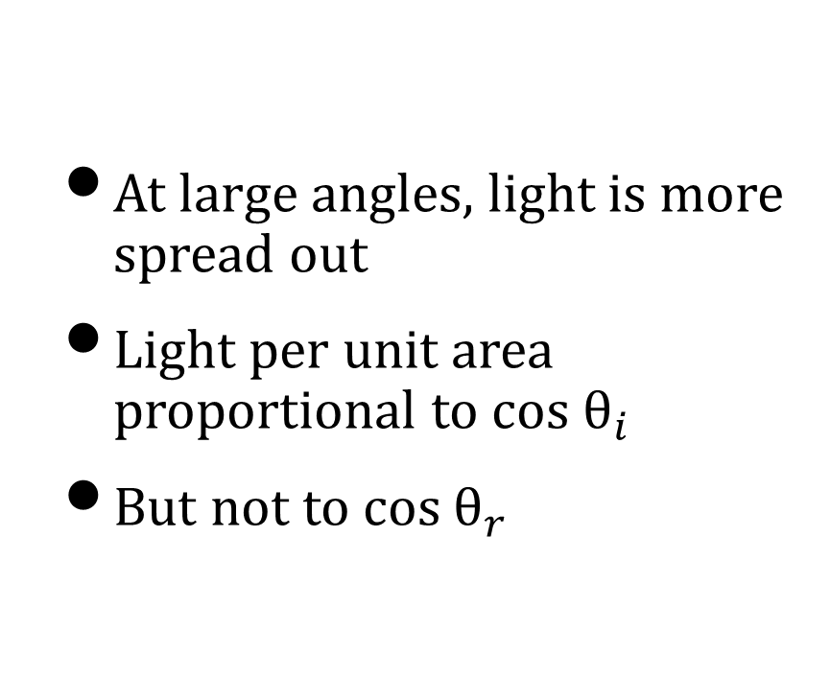
Diffuse Lighting
At large angles, light is more spread out
Light per unit area proportional to cos $θ_{i}$
But not to cos $θ_{r}$

Slide 41
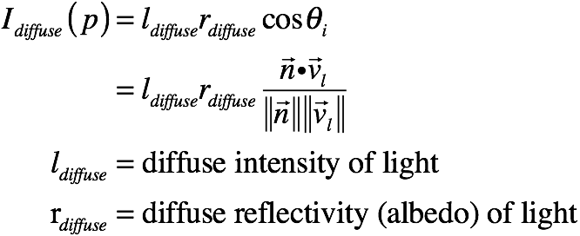
Diffuse Computation
Light is spread over surface
depending on incident angle
but not on reflection angle

Slide 42
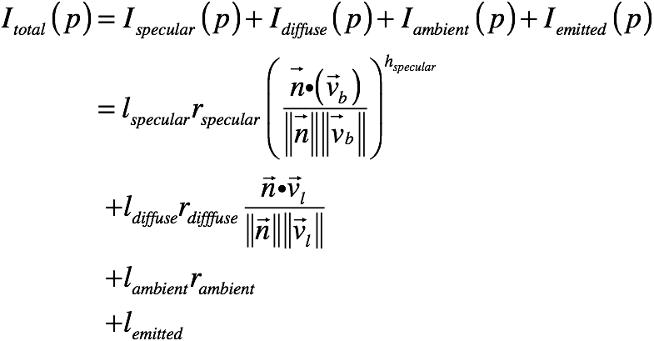
Putting it Back Together
For colour, do this once each for R,G,B

Slide 43
One Step At A Time
RGB ~ i,j (debug)
RGB ~ αβγ (debug)
Lambertian (diffuse)
Blinn-Phong

Slide 44
Saving to PPM File
A common convention when testing
Dump the image to a file
PPM is a very simple text format
Inefficient, but simple
Simplifies the debug cycle
But only allows integer values
Usually in the range 0-255
Debug hint for A1!!

Slide 45
Images by
S19 - Apurv das
S32- Photographycourse
S33 - Jake Givens
S39 - Greg Rosenke
From Unsplash.com

